Slide 1


COMPUTER USE AGENT
CAPSTONE PROJECT
Rajat Jaiswal (52346854)
HCL TECH
Shivanshu Kumar ( 52346821)
Aryan Singla ( 52346825)
Mentor : M Hari s

Slide 2
🧭 Overview
The Computer Use Agent (CUA) combines LLM reasoning, vision understanding, and real browser automation to perform UI tasks just like a human tester.
Users simply provide test steps in plain English, and the agent:
  Interprets the instructions
  Interacts with a real browser (click, type, scroll, navigate)
  Evaluates results
  Generates test reports with screenshots
This enables scriptless automation, reduces manual effort, and improves test coverage.
HCL TECH

Slide 3
What we are solving ?
1. ⏱️ Manual Testing Is Slow
Execution takes hours for full coverage
Regression tests are repetitive and resource-heavy
Hard to scale across many scenarios
2. 🔧 Traditional Automation Has Limits
HCL TECH
Requires coding skills (Selenium, Cypress)
Scripts break easily with UI changes
High maintenance effort

Slide 4
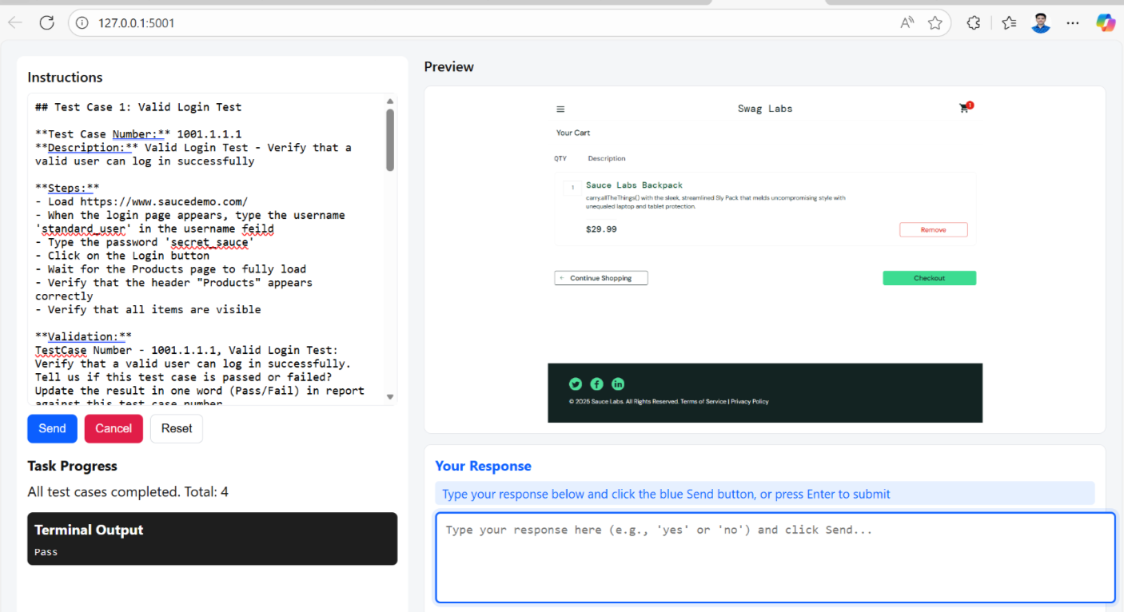
HCL TECH

